Slide 1
Socket programming
Nisheeth
August 22nd 2019

Slide 2
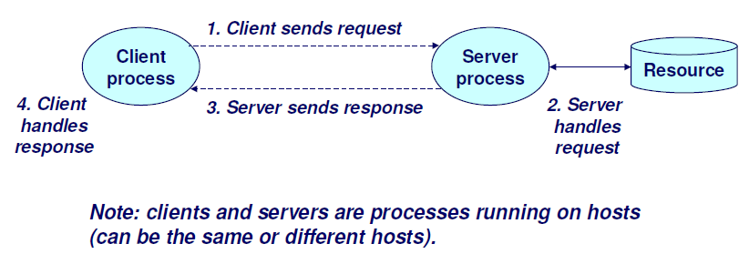
Client-server model
A server process and one or more client processes
Server manages some resource
Server provides service by manipulating resource for clients

Slide 3
Networking 101
The TCP/IP communication stack has four layers
Link layer
Communication protocols for physically linked devices
Internet layer
Communication protocols across networks
Transport layer
Host-to-host communication services
Application layer
Process-to-process communication methods across networks

Slide 4
Networking 101
The TCP/IP communication stack has four layers
Link layer
Communication protocols for physically linked devices
Internet layer
Communication protocols across networks
Transport layer
Host-to-host communication services
Our main focus today
Application layer
Process-to-process communication methods across networks

Slide 5
MAC: A link layer protocol
Medium access control (MAC) controls the hardware responsible for the machine’s interaction with the transmission medium
Cable
Wifi
Each machine on a LAN has a network interface (e.g. ethernet card) connected to a common broadcast medium
Each interface card is associated with a MAC address

Slide 6
MAC address
48 bit unique identifier assigned to a network interface controller
Human readable format: six octets represented in hex
01-23-45-67-89-AB
32:12:34:6F:45:AD
Of six octets
First three are manufacturing organization identifiers
Last three are device identifiers assigned by manufacturer

Slide 7
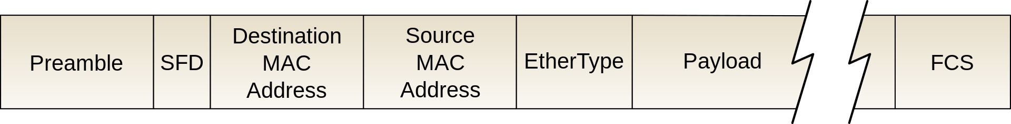
Ethernet frame format
Data frames on ethernet are packets of a specific size and format

Slide 8
Ethernet communication protocol
The sender broadcasts
Each host connected to the LAN checks destination address in data frame with own MAC address
If destination matches, receive the packet
Is this a good protocol?

Slide 9
Internet layer
Multiple LANs want to communicate with each other
Most popular protocol is the internet protocol (IP)
Data packets routed to devices on other networks
Each network interface of a device connected to the internet has an IP address
IPv4 uses 32 bit addressing
IPv6 uses 128 bit addressing
Routing efficiency is a function of IP address allocation protocols

Slide 10
IPv4 problems
Too few unique addresses available
Forced lots of hacky solutions
Example: NAT
Try to find your IP using ifconfig
Try to find your IP using a third party lookup service
Why is there a difference?
In the process of replacement by IPv6
For the time being, have to remain aware of hacks

Slide 11
Transport layer
How is data to be transmitted, once we know how to send a data packet to any other device in the world?
Two common paradigms
TCP (connections)
UDP (datagrams)
Socket programming is an excellent introduction to both

Slide 12
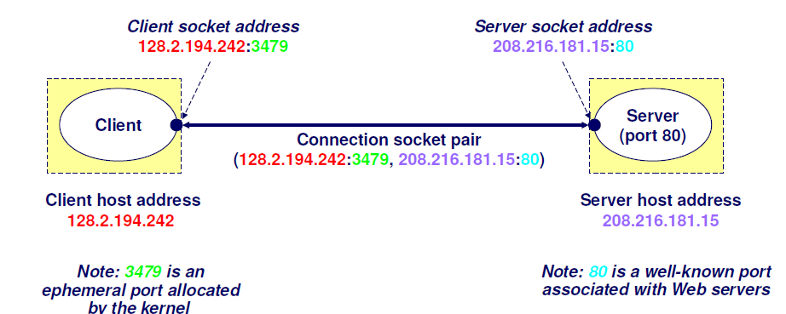
Sockets
Sockets make network I/O look like file I/O
Call system functions to control and communicate
Network code handles packet assembly, fragmentation and routing

Slide 13
Client programs
Examples of client programs
http, ftp, telnet, ssh
How does a client find a server?
The IP address in the server socket address identifies an adapter on the host
The port in the server socket address identifies the service
Port 7 = ping
Port 22 = ssh
Port 80 = http

Slide 14
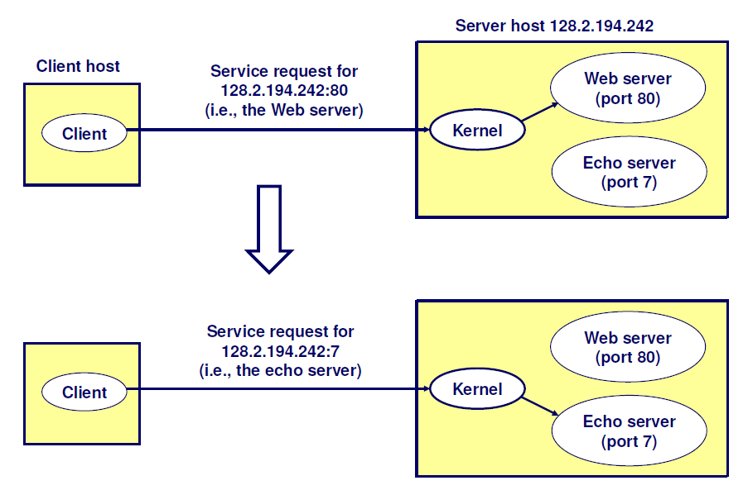
Using ports to identify services

Slide 15
Servers
Servers are long-running processes (daemons)
Created at boot-time by the init process
Run continuously until the machine is turned off
Do you know what services are running on your Linux installation?
See /etc/services
Note that each service’s transport protocol is specified as either TCP or UDP
A machine that runs a server process is called a server

Slide 16
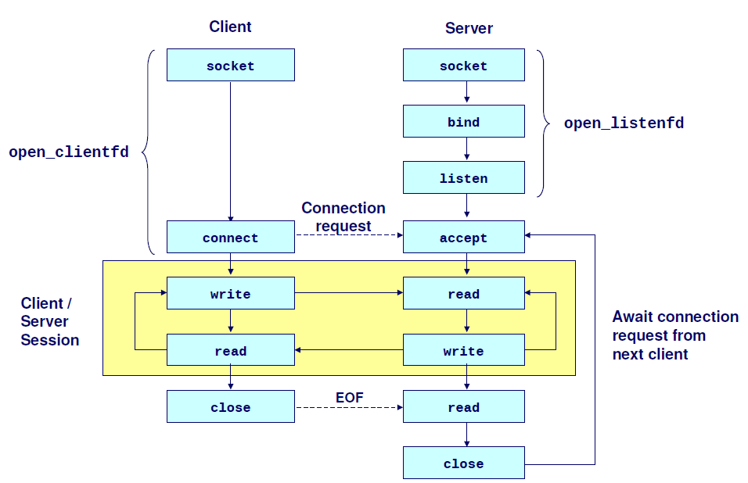
Sockets overview

Slide 17
Sockets
The Bible of socket programming
Beej’s network programming guide
Helpful and a fun read too
What is a socket?
To the kernel, a socket is an endpoint for communication
To an application, a socket is a file descriptor that lets the application read/write
The main difference between file I/O and network I/O is how the application opens the socket descriptors

Slide 18
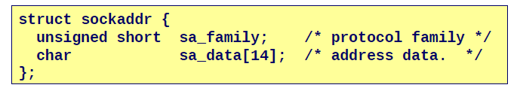
Socket programming basics
The most important component of a socket transaction
The socket address
Stored in a struct
Internet-based socket addresses get a lot more detail

Slide 19
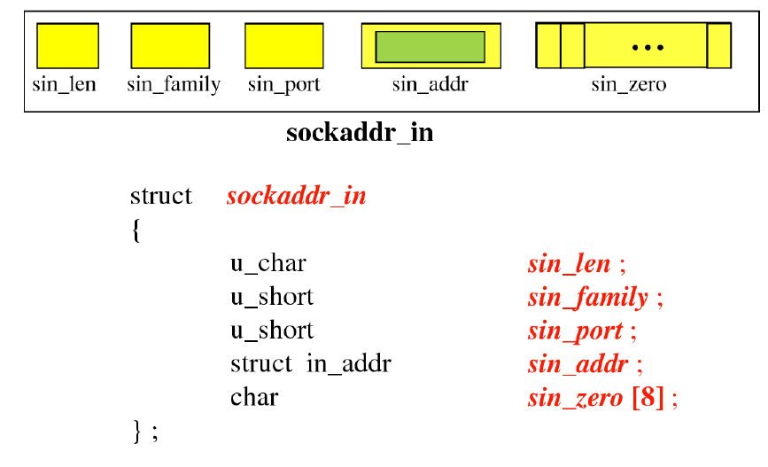
Internet-based socket addresses

Slide 20
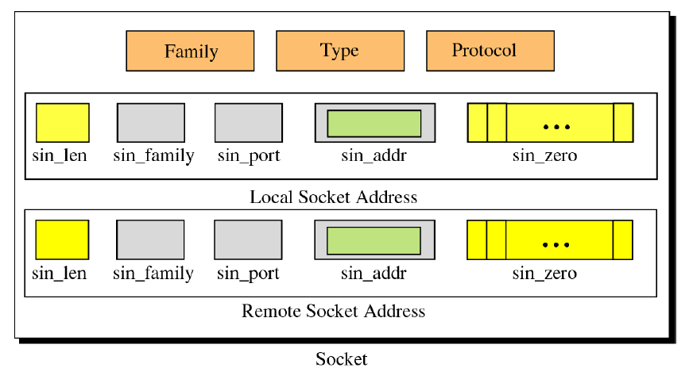
Socket structure

Slide 21
Using socket addresses
Write a simple C file including the necessary header files
Create this structure and call the function getaddrinfo()
struct addrinfo {
int ai_flags; // AI_PASSIVE, AI_CANONNAME, etc.
int ai_family; // AF_INET, AF_INET6, AF_UNSPEC
int ai_socktype; // SOCK_STREAM, SOCK_DGRAM
int ai_protocol; // use 0 for "any"
size_int ai_addrlen; // size of ai_addr in bytes
struct sockaddr *ai_addr; // struct sockaddr_in or _in6
char *ai_canonname; // full canonical hostname
struct addrinfo *ai_next; // linked list, next node
};

Slide 22
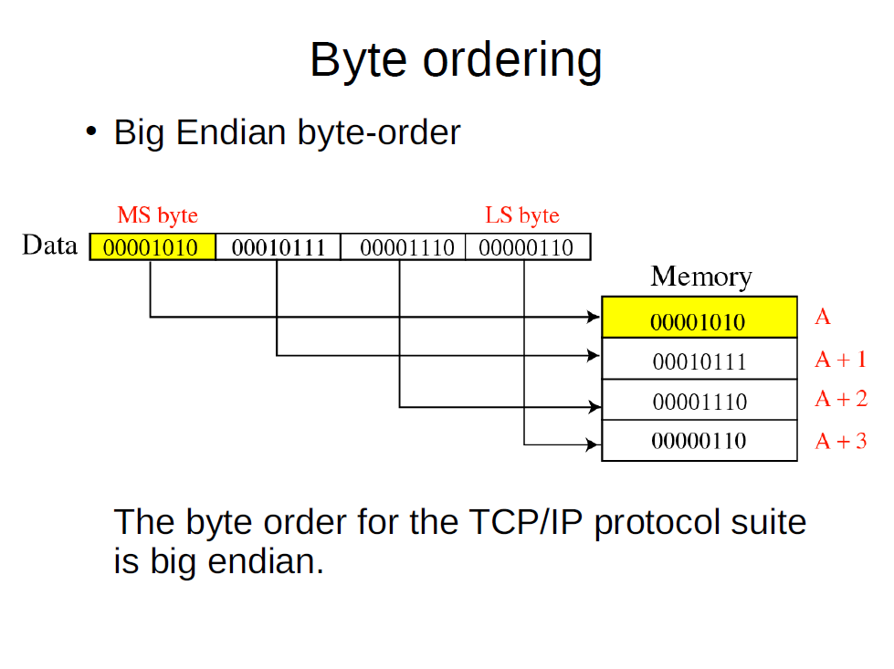

Slide 23
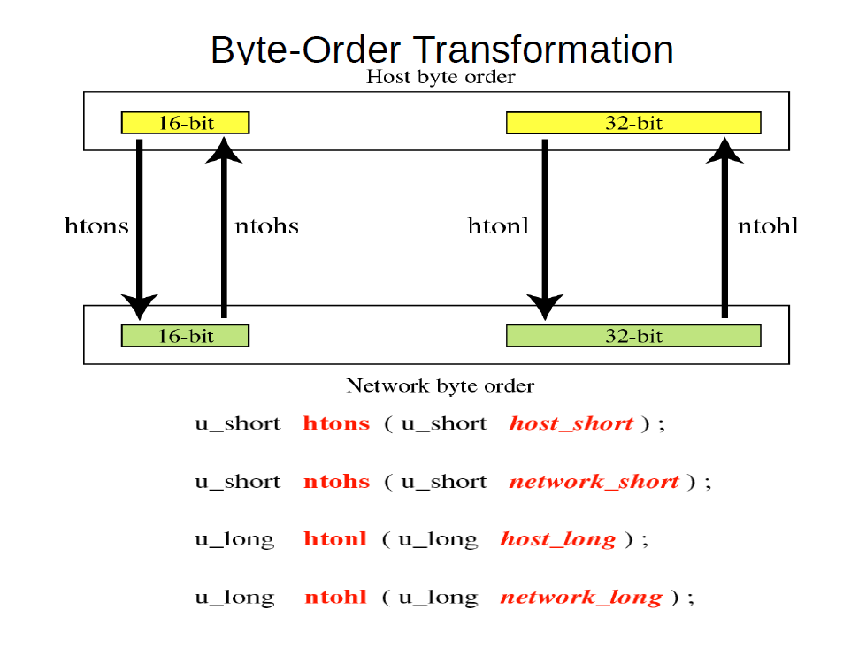

Slide 24
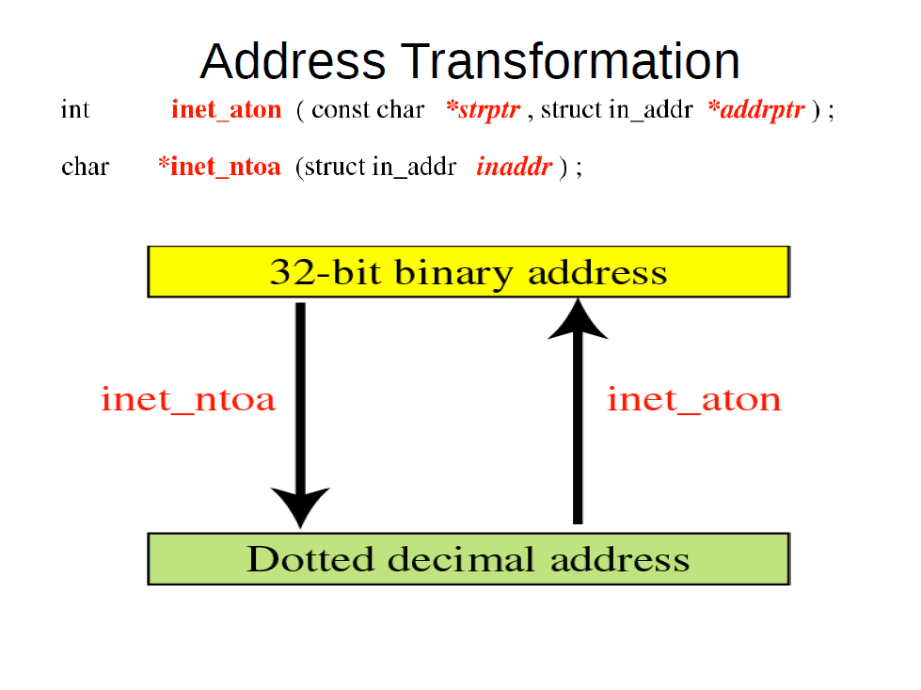

Slide 25
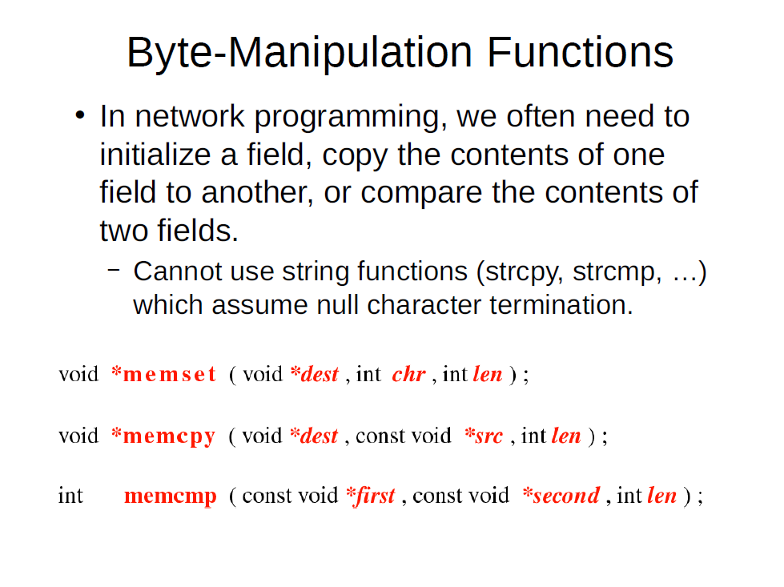

Slide 26
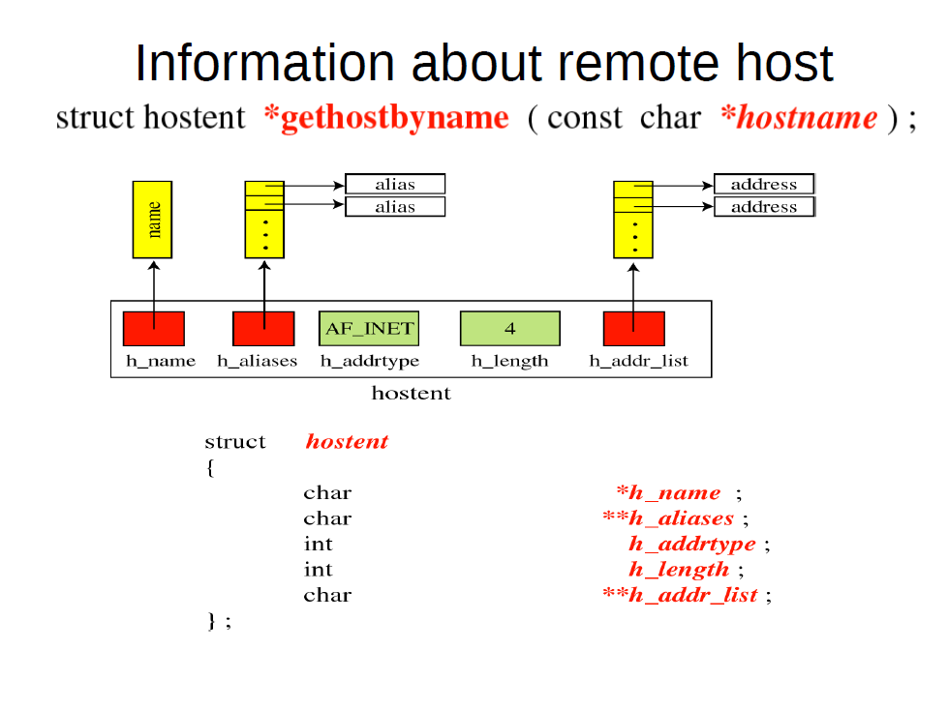

Slide 27
Don’t panic
Beej’s guide is your friend
I will give you basic client-server socket code as a baseline
For any function that seems unfamiliar, just read the corresponding entry in beej’s guide

Slide 28
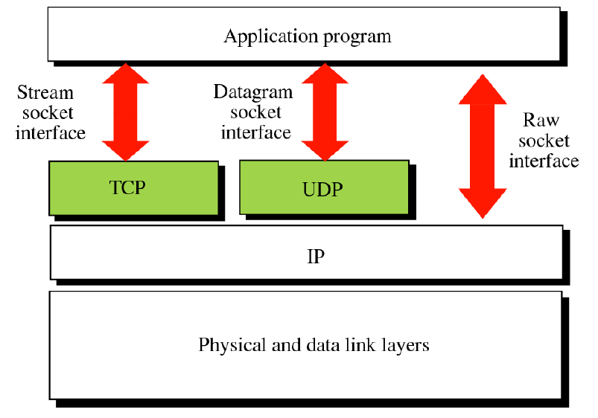
Socket types

Slide 29
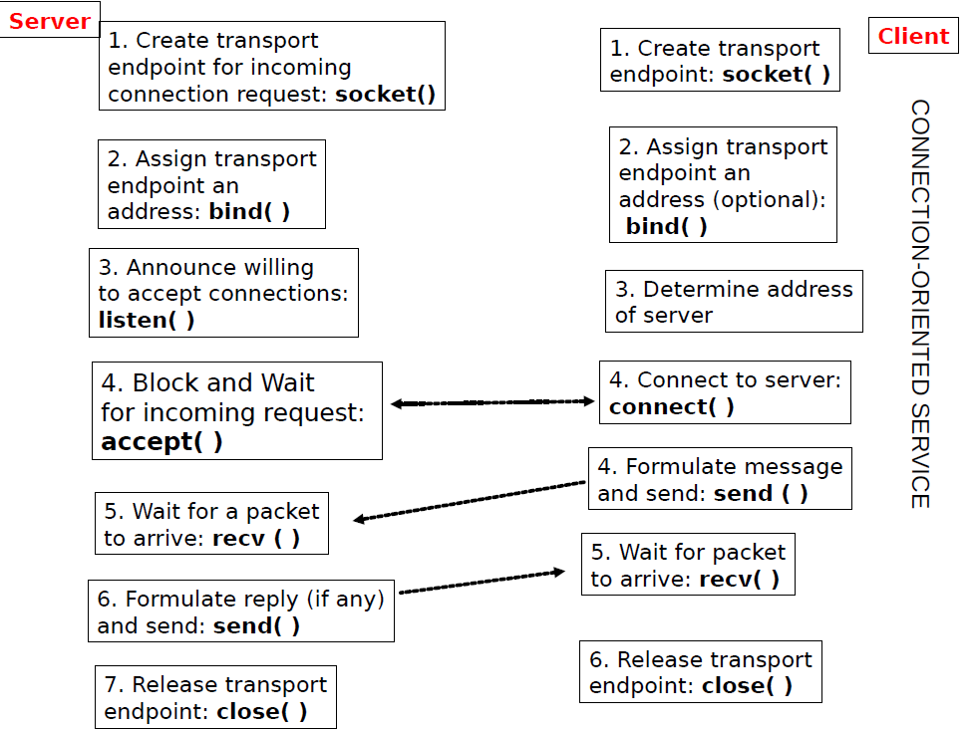

Slide 30
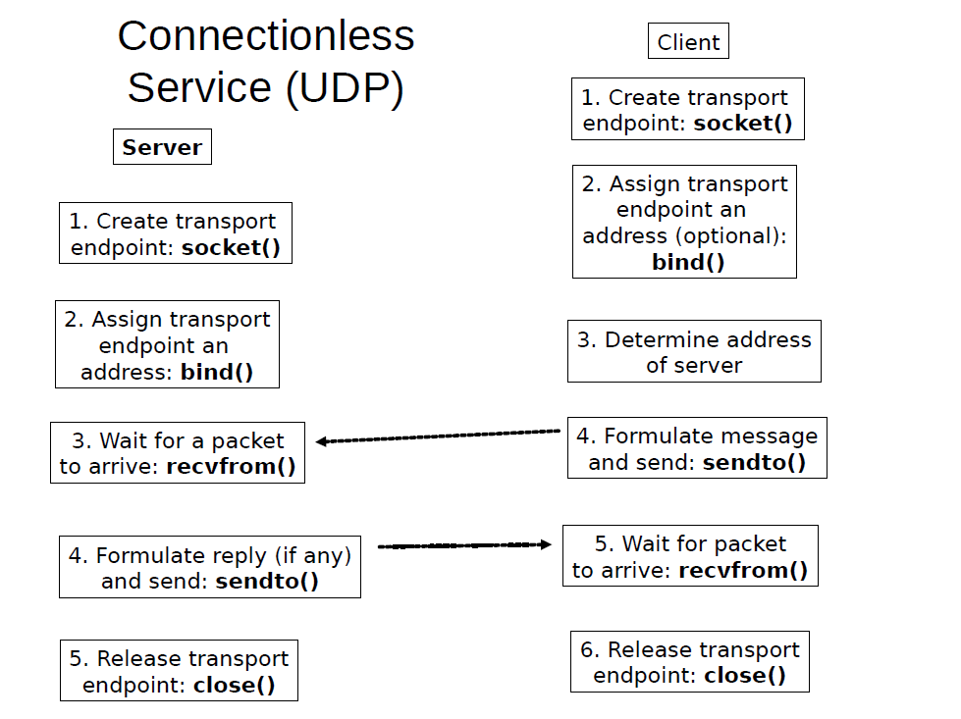

Slide 31
Lab this week
Grab the simple client-server demo in C from my github
If you run the server code on one local terminal and the client code on another
It will transmit a Hello world message and quit

Slide 32
Lab this week
Make the server persistent, such that it doesn’t quit after one message transfer
Redesign the server such that
it accepts inputs from the client,
transforms them into lowercase and
transmits back
Redesign the server and client such that
The client requests an HTML page stored on the server, that is displaying some headers and a simple table
The server sends the file to the client as text
The client code calls a shell script to display the corresponding webpage on the client’s computer

Slide 33
Lab this week
Create a version of the server that will allow connectionless (UDP) transfer
See if you can get the HTML transfer to work on this connection too
Create a version of the TCP server that will permit concurrent connections from multiple clients (*)

